Slide 1
Metabolic Control Systems

Slide 2
Learning Objectives
Understand what a rate limiting enzyme is, what a committed enzyme step is and what a reversible reaction is.
Explain the differences in speed and persistence of allosteric, post-translational and transcriptional regulation of metabolism.
Describe the role of cellular transport in macromolecular regulation. Understand the differences between active and passive transport.
Understand the partitioning of macronutrients under resting conditions.
Describe how hormones alter macronutrient metabolism after a meal.
Explain the roles of hormones that maintain glucose levels in the fasting state.
Understand how metabolic rates are changed in response to diets and overfeeding.

Slide 3
Nutrient Regulation is About Two Things
Metabolism
Catabolism
Anabolism
Transport
What statement about enzymes is untrue?
Enzymes stabilize a transition state intermediate
Enzymes change the equilibrium levels of products and substrates
Enzymes can accelerate a chemical reaction
Enzymes can be proteins or mRNA

Slide 4
(Very) Quick Review of Enzymes

Slide 5
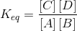
Thermodynamics of Metabolic Pathways
Notes:
Standard free energy
Actual free energy

Slide 6
Is this reaction spontaneous?
ΔG = +2 kJ/mol
Glucose – 6 – Phosphate
Fructose– 6 – Phosphate
True
False

Slide 7
Is this reaction spontaneous?
ΔG = +22 kJ/mol
True
False
Notes:
This reaction happens all the time, so how does it happen?

Slide 8
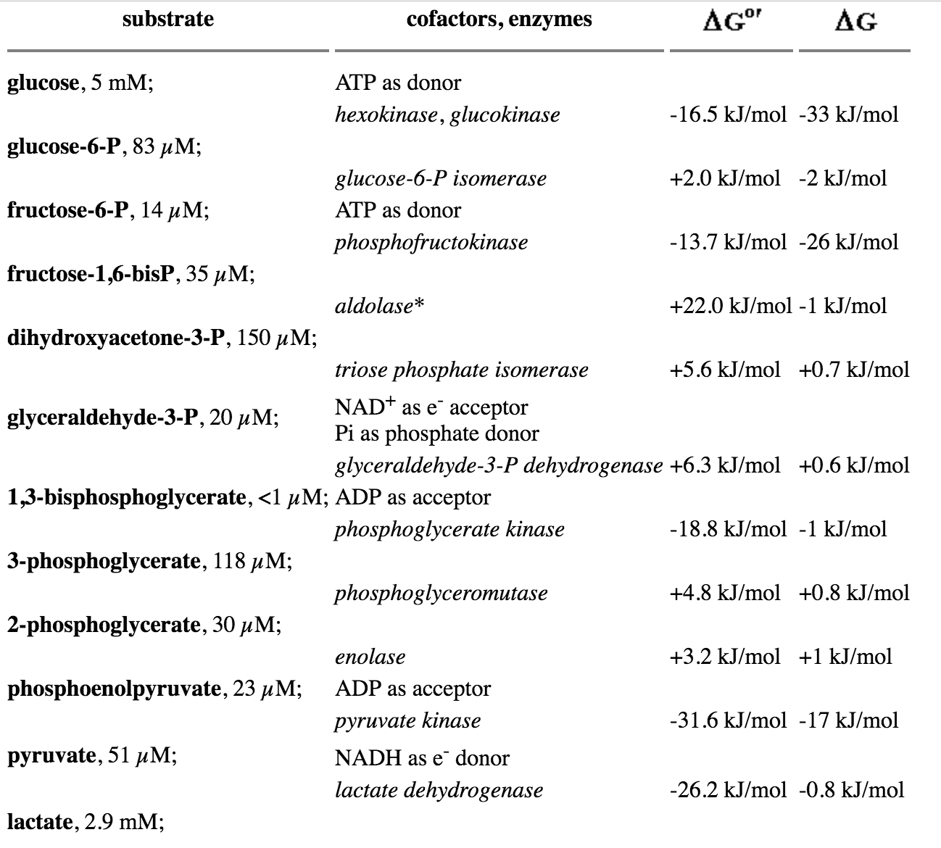
After adjusting for
Concentrations of reactants

Slide 9
Enzymes are Regulated by Several Mechanisms
Speed
Substrate/Product Concentrations
Allosteric Control
Enzymatic Activity
Enzyme Location
Enzyme Levels
Protein Level -> Translation/Degradation
Transcriptional Regulation
Permanence
Notes:
Allosteric Control

Slide 10
Cellular Transport Mechanisms

Slide 11
Cellular transport
Cells are impermeable to many nutrients
Transport can:
Follow concentration gradient
Passive transport
Push against concentration gradient
Active transport
Same concepts are true for mitochondrial transport

Slide 12
The Energy from Active Transport Can Come from Several Sources

Slide 13
Altering Cellular Transport
With the folks nearby think of as many ways as you can by which you could increase cellular transport of a nutrient (I can think of 5)
Notes:
Increase rate of transporter
Steepen concentration gradient of nutrient
Make more transporters
Change concentration of co- or antiported molecules
Make more ATP

Slide 14
Cell Autonomous Metabolic Control

Slide 15
Integrated Control of Metabolism

Slide 16
Neuroendocrine Control

Slide 17
Basic endocrine regulation of nutrition
Hormones
Main Regulatory Processes
Insulin
Glucagon
Adrenaline
Cortisol
Glucose
Gluconeogenesis
Glucose Oxidation
Glycogen Storage
Lipids
Transport (Lipolysis)
Storage
Fatty Acid Oxidation
Proteins and Amino Acids
Protein Synthesis or Breakdown
Amino Acid Synthesis or Catabolism
Amino Acid Import or Export
Notes:
Talk about what the hormones are trying to accomplish

Slide 18
Metabolic Hormones Assignment
Tissue | Insulin | Glucagon | Adrenaline | Cortisol
Muscle
Liver
Fat
Notes:
Take 5-10 minutes thinking about this

Slide 19
Macronutrient partitioning
Resting
Fasting
After a meal

Slide 20
Fasting Hormones

Slide 21
Postprandial hormones

Slide 22
How do we measure metabolic rates

Slide 23
Parts of the Metabolic Rate Metabolic Rate
Maclean PS, Bergouignan A, Cornier M-A, Jackman MR. Biology’s response to dieting: the impetus for weight regain. Am. J. Physiol. Regul. Integr. Comp. Physiol. 2011;301(3):R581–R600. http://dx.doi.org/10.1152/ajpregu.00755.2010
Notes:
Impact of weight loss on the components of total energy expenditure (TEE). Energy-restricted weight loss impacts every component of energy expenditure. The absolute levels of resting energy expenditure (REE) decline from a loss of metabolic mass and enhanced metabolic efficiency. Nonresting energy expenditure (NREE) declines, unless the level of physical activity and its associated exercise activity thermogenesis (EAT) are substantially increased. This increase must overcome the decline in the TEF that results from lower energy consumption and a decline in nonexercise activity thermogenesis (NEAT) related to loss in overall mass. Increased energetic efficiency of EAT, NEAT, and potentially TEF contribute to the overall decline in NREE.

Slide 24
Over/underfeeding and metabolic rates
Leibel R, Osenbaum MIR, Leibel RL, Rosenbaum M, Hirsch J. Changes in energy expenditure resulting from altered body weight. N. Engl. J. Med. 1995;332(10):621–8. http://dx.doi.org/10.1056/NEJM199503093321001

Slide 25
The Biggest Loser Follow-Up Study

Slide 26
Learning Objectives
Understand what a rate limiting enzyme is, what a committed enzyme step is and what a reversible reaction is.
Explain the differences in speed and persistence of allosteric, post-translational and transcriptional regulation of metabolism.
Describe the role of cellular transport in macromolecular regulation. Understand the differences between active and passive transport.
Understand the partitioning of macronutrients under resting conditions.
Describe how hormones alter macronutrient metabolism after a meal.
Explain the roles of hormones that maintain glucose levels in the fasting state.
Understand how metabolic rates are changed in response to diets and overfeeding.

